Slide 1
Hard System ThInkIng
Efe Erdur
Ismail Cosgun
Serhat Can

Slide 2
IntroductIon To Hard System ThInkIng
OUTLINE
Concept of Hard Systems Thinking
Themes of natural, abstract and engineered systems
Quantification
Nature of problems
Analyst-client Relationship
Hard Systems Methodology

Slide 3
Concept of Hard Systems ThInkIng
Hard refers to attiributes perceived to be;
Quantifiable
Predictable
Relatively undisputed
Hard does not refer to something complex or hard to understand
«Hard systems thinking is an approach to real-world problems in which an objective or end-to-be-achieved can be taken as given.»[2]
Human behaviour plays a minor role
Notes:
When someone says «give me the hard facts».

Slide 4
Concept of Hard Systems ThInkIng
Key points in Hard Systems Thinking;
Problem is structured
There is a gap between Present State and Desired State
How to make the gap disappear is the problem.
Does not give weight to un-quantifiable variables (eg. politics, culture)
Notes:
We never care about un-quantifiable variables

Slide 5
Themes of natural, abstract and engIneered systems
Natural Systems
Not human-made systems
Biological systems, oceans, weather systems, micro organisms
Abstract Systems
Created by human mind
Conceptual or non-physical entities
Languages, mathematical systems.
Engineered or Designed Technical Systems
Tangible entities; maybe static or dynamic in operation
Central Heating System, City’s Underground System

Slide 6
engIneered systems
What is engineered or designed technical systems?
A system that;
includes hardware, equipment or technical processes
Has been designed to achieve certain goals
The central heating system, a car, a computing system etc.

Slide 7
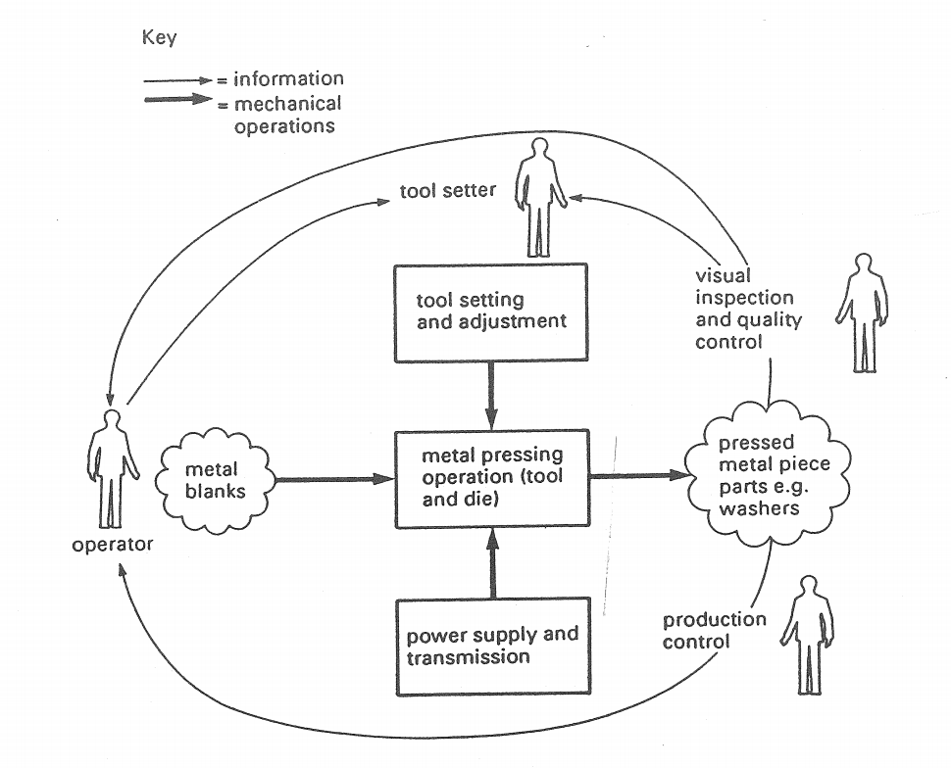
engIneered systems
Diagram of a metal power system

Slide 8
Quantıfıcatıon
Quantifiable measures are used to predict and control of the hard systems.
Is success being achieved?
How to measure performance?
Is system functioning accurate and efficiently?
Quantifyible parameters and types maybe different in different systems;
Memory size or storage capacity in a computer system
System efficiency is measured by benchmarks
Car fuel consumption, domestic electricity consumption etc.

Slide 9
Nature of problems
Normal problem solving procedure;
Problem Definition.
Problem Analysis.
Generating possible Solutions.
Analyzing the Solutions.
Selecting the best solution(s).
Planning the next course of action

Slide 10
Nature of problems
FORMAL PROBLEM SOLVING
Set of assumptions on the part of problem solvers on formal problem solving;
The existence of the problem may be taken for granted
The structure of the problem can be simplified or reduced so as to make its definition, description and solution manageable
Reduction of the problem does not reduce the effectiveness of the solution
An optimal or superior solution exists
Selection of the optimal solution is a rational process of comparison

Slide 11
Nature of problems
Hard system approach;
Methodology
On the second part!
Important Question
Who says that X is a problem?
Problems do not have physical existance
Problem or opportunity? No paticular opinion?

Slide 12
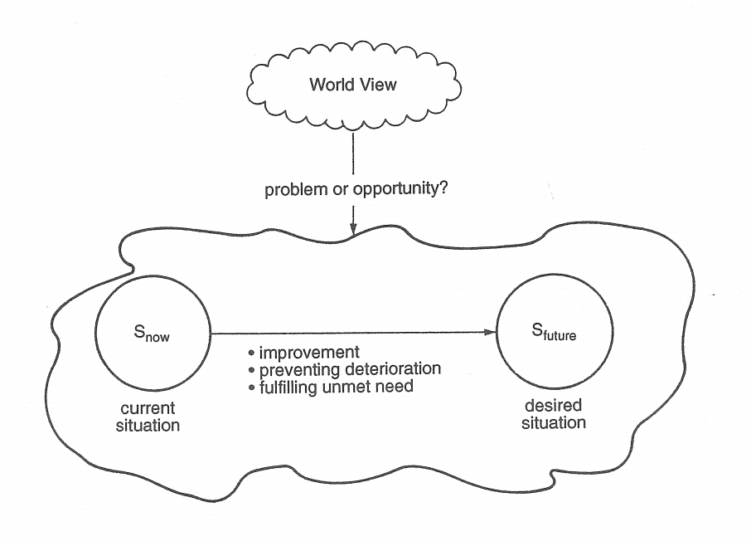
Nature of problems
Analyst’s task is;
Devising ways from S(now) to S(future)
Which is the most effective option

Slide 13
Analyst-clIent RelatIonshIp
Client-set is one person or a number of people for whom the systems study is done.
System owner, problem owner and the client-set may be different people or just one person.

Slide 14
Analyst-clIent RelatIonshIp
First step of analyst is to decide about client-set:
Who is the client-set?
What are their interests?
What are their world-view?
Analyst should accept Client-Set’s world view.

Slide 15
Hard Systems Methodology
Formal problem solving is relatively straight forward.
Formal problem solving is used when past practice, experience etc. is not enough
It is prescriptive and depends on assumptions

Slide 16
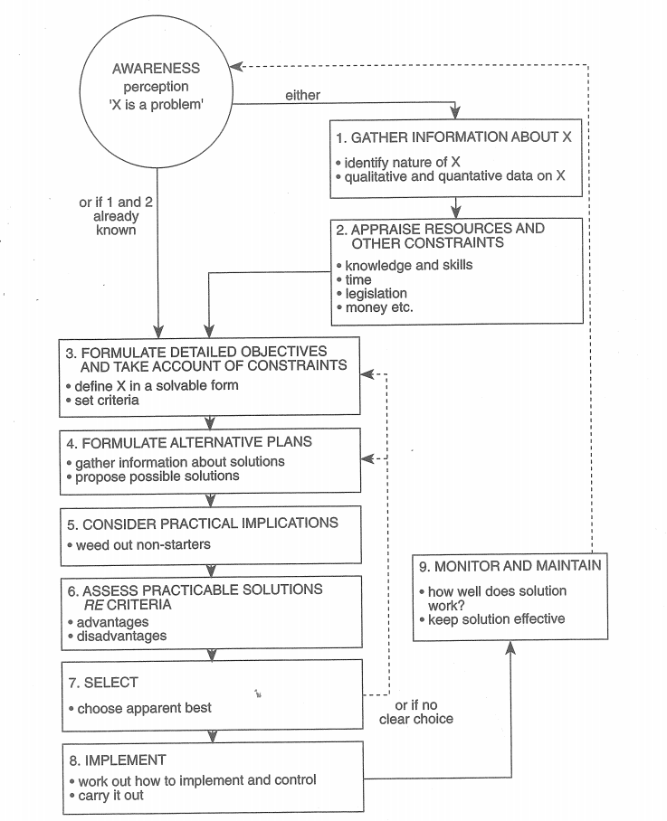
Hard Systems Methodology
Formal problem solving proecedure as a decision squence diagram

Slide 17
Hard Systems Methodology
What about more complex problems? Or there are too many variables?

Slide 18
Hard Systems Methodology
Doing the groundwork
Gaining awareness and understanding of the perceived problem
Establishing overall goal and set of objectives
Finding ways to reach objectives
Devising assessment measures
Modeling
Evaluation
Making a choice
Implementation
The steps are not have to be serial
Notes:
Some experts Open University system group btw. 84-93

Slide 19
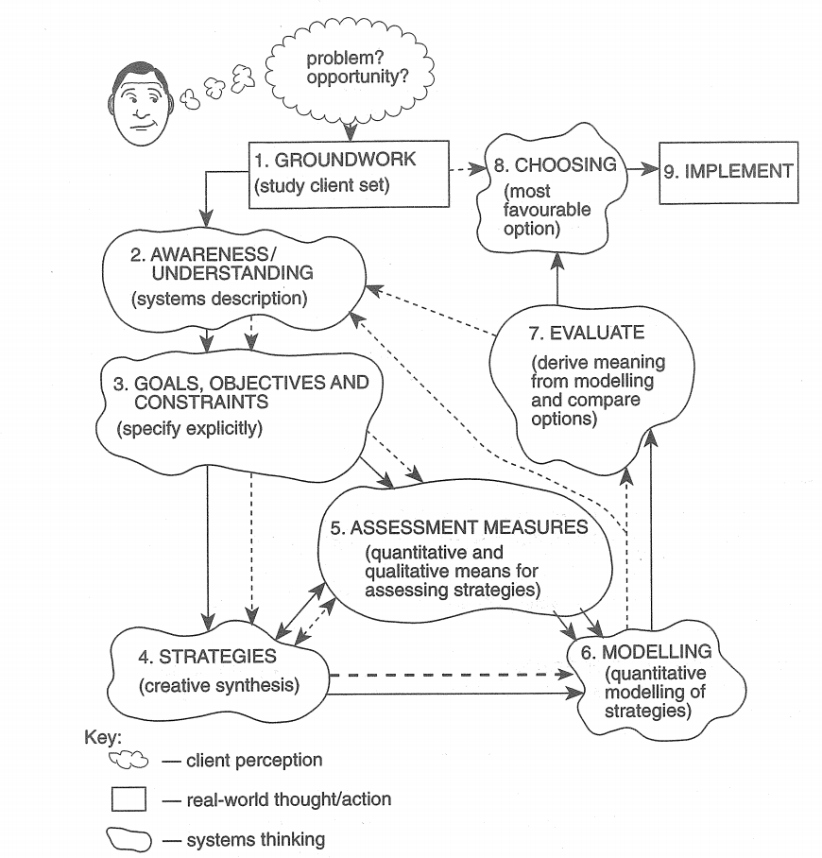
Hard Systems Methodology
Notes:
descriptions

Slide 20
References
Waring, A. (1996). Practical Systems Thinking, International Thomson Business Press.
Systems Thinking, Systems Practice, Peter Checkland, 1981, page 138 - 139, 146
http://iansommerville.com/systems-software-and-technology/designed-physical-and-designed-abstract-systems/
https://www.slideshare.net/rraajjoonn/01-isadinformation-system-analysis-and-design-intro-by-s-a-ahsan-rajon

